Slide 1
Web Technologies
Week 1 - Introduction

Slide 2





Web Essentials
Client: web browsers, used to surf the Web
Server systems: used to supply information to these browsers
Computer networks: used to support the browser-server
communication
Request “document A”
document A
Client
Internet
Server

Slide 3

Internet
The Internet: a inter-connected computer networks, linked by wires, cables, wireless connections, etc.
Web: a collection of interconnected documents and other resources.
v.s. Web
The world wide web (WWW) is accessible via the Internet, as are many other services including email, file sharing, etc.

Slide 4
Through communication protocols
A communication protocol is a specification of how communication between two computers will be carried out
 | TCP (Transmission | Other application
IP (Internet | Control Protocol) | protocols: DNS
Protocol): defines | and UDP (User | (Domain Name
the packets that | Datagram | Service), SMTP
carry blocks of | Protocol): the | (Simple Mail
data from one | protocols by which | Transfer Protocol),
node to another | one host sends | and FTP (File
 | data to another. | Transfer Protocol)
How does the Internet Work?

Slide 5
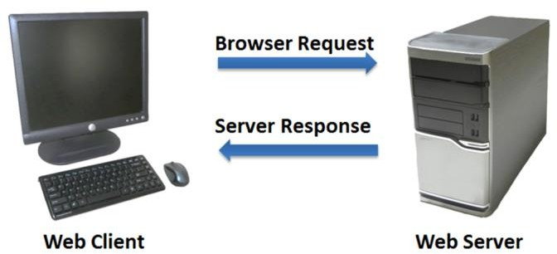
The World Wide Web (WWW)
WWW is a system of interlinked, hypertext documents that runs over the Internet
Two types of software:
  Client: a system that wishes to access the information provided by
servers must run client software (e.g., web browser)
  Server: an internet-connected computer that wishes to provide information to others must run server software
  Client and server applications communicate over the Internet by following a protocol built on top of TCP/IP – HyperText Transfer Protocol (HTTP)

Slide 6
Basics of the WWW
Hypertext: a format of information which allows one to move from one part of a document to another or from one document to another through hyperlinks
Uniform Resource Locator (URL): unique identifiers used to locate a
particular resource on the network
Markup language: defines the structure and content of hypertext documents

Slide 7
Web Client: Browser
Makes HTTP requests on behalf of the user
  Reformat the URL entered as a valid HTTP request
  Use DNS to convert server’s host name to appropriate IP address
  Establish a TCP connection using the IP address
  Send HTTP request over the connection and wait for server’s response
  Display the document contained in the response
    If the document is not a plain-text document but instead is written in HTML, this involves rendering the document (positioning text, graphics, creating table borders, using appropriate fonts, etc.)

Slide 8
Web Servers
Main functionalities:
  Server waits for connect requests
  When a connection request is received, the server creates a new
process to handle this connection
  The new process establishes the TCP connection and waits for HTTP requests
  The new process invokes software that maps the requested URL to a
resource on the server
  If the resource is a file, creates an HTTP response that contains the file in the body of the response message
  If the resource is a program, runs the program, and returns the output

Slide 9
Domain Name
Locates an organization or other entity on the Internet
Domain Name System (DNS)
  Divides the Internet into logical groups and understandable names
  Associates unique computer IP Addresses with the text-based domain
names you type into a web browser
  Browser: http://google.com
  IP Address: 173.194.116.72

Slide 10
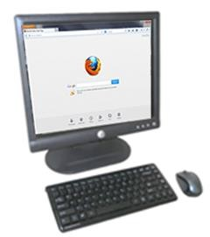
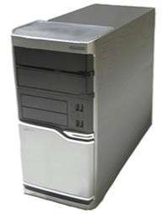
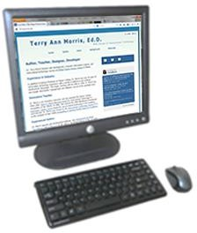
Domain Name System
The Domain Name System (DNS) associates Domain Names with IP
addresses.
Domain Name
IP Address
DNS
Web Browser
Web
Server
Use TCP/IP to send HTTP Request
Use TCP/IP to send HTTP Responses with web page files & images
Web Browser displays web page

Slide 11
Top-Level Domain (TLD) Name
A top-level domain (TLD) identifies the right-most part of the domain name.
Examples of generic TLDs:
.com, .org, .net, .mil, .gov, .edu, .int, .aero, .asia, .cat, .jobs, .name,
.biz, .mobi, .museum, .info, .coop, .post, .pro, .tel, .travel

Slide 12
County Code TLDs
Two character codes originally intended to indicate the geographical location (country) of the web site.
In practice, it is fairly easy to obtain a domain name
with a country code TLD that is not local to the registrant.
Examples:
  .tv, .ws, .au, .jp, .uk
  See http://www.iana.org/cctld/cctld-whois.htm

Slide 13
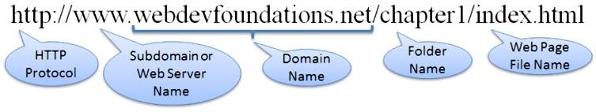
Uniform Resource Identifier
URI – Uniform Resource Identifier
  identifies a resource on the Internet
URL – Uniform Resource Locator
  a type of URI which represents the network location of a resource
such as a web page, a graphic file, or an MP3 file.
27

Slide 14
Static Web: HTML/XHTML, CSS
HTML stands for HyperText Markup Language
  It is a text file containing small markup tags that tell the Web browser how to display the page
XHTML stands for eXtensible HyperText Markup Language
  It is identical to HTML 4.01
  It is a stricter and cleaner version of HTML
  E.g., <!DOCTYPE>, <html>, <head>, and <body> are mandatory
CSS stands for Cascading Style Sheets
  It defines how to display HTML elements

Slide 15
Static web limitations
What is the drawback to simple document model?
  Static
  Assume that documents are created before they are requested
What are examples of information that might be part of web documents that may not be known before they are requested?

Slide 16
Client-Side Programming
Scripting language: a lightweight programming language
Browser scripting: JavaScript
  Designed to add interactivity to HTML pages
  Usually embedded into HTML pages
  What can a JavaScript Do?
    Put dynamic text into an HTML page
    React to events
    Read and write HTML elements
    Validate data before it is submitted to a server
    Create cookies
    …

Slide 17
Server-Side Programming
The requests cause the response to be generated
Server scripting:
  ASP.Net MVC: Microsoft product, uses .Net framework (*.asp)
  CGI/Perl: Common Gate Way Interface (*.pl, *.cgi)
  PHP: Open source, strong database support (*.php)
  Java via JavaServer Pages (*.jsp)
  …

Slide 18
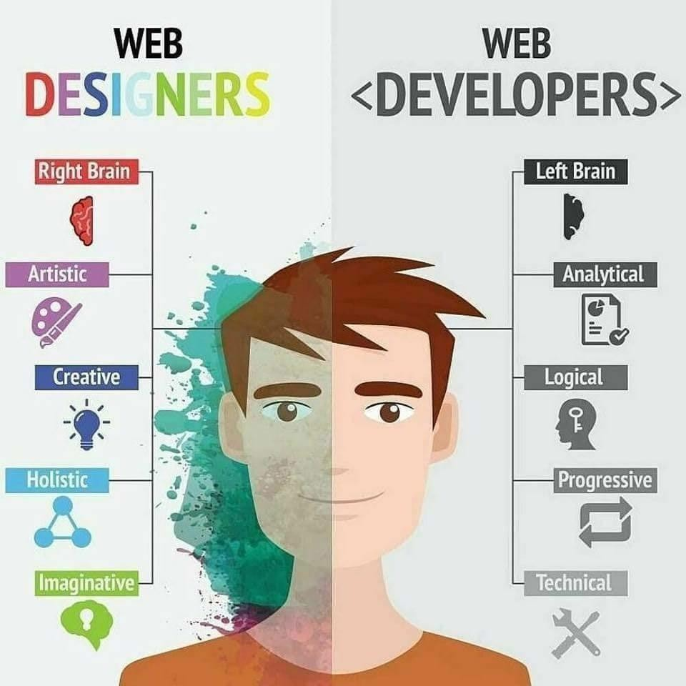
Web Development vs Designing
32

Slide 19


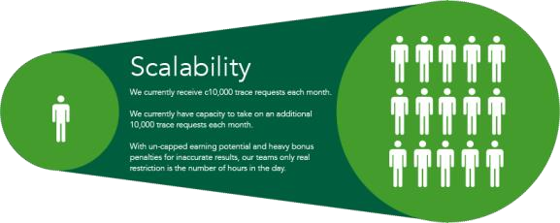
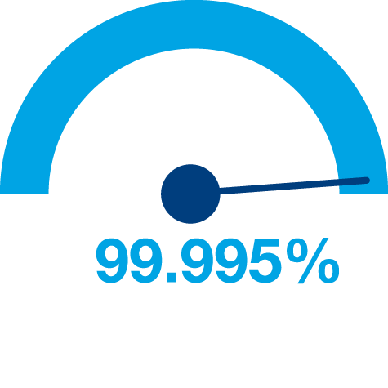

Principles of Web Design
Availability
Performance
Reliability
Scalability
Manageability
Cost
33

Slide 20
Evolution of Web
Web 1.0: The Read-Only Web
Web 1.0, also known as the "read-only web," was the first stage of the World Wide Web's evolution. It was characterized by static web pages that were primarily informational and lacked interactivity. Users could only read content, and there was minimal user-generated content. Key features of Web 1.0 include:
Static Pages: Content was served from the server's file system and displayed as static HTML pages.
Limited Interaction: There was little to no interaction between users and the server.
Content Delivery Network (CDN): Web 1.0 functioned as a CDN, allowing users to access information but not interact with it.

Slide 21
Evolution of Web
Web 2.0: The Participative Social Web
Web 2.0, often referred to as the "participative social web," marked a significant shift towards user-generated content and interactivity. This phase emphasized collaboration, sharing, and social networking. Key features of Web 2.0 include:
Dynamic Content: Content became more dynamic and responsive to user input.
User-Generated Content: Platforms like blogs, wikis, and social media allowed users to create and share content.
Interactivity: Web 2.0 introduced interactive features such as commenting, tagging, and social networking.
APIs and Web Services: Developed APIs allowed for greater integration and interoperability between different web services.

Slide 22
Evolution of Web
Web 3.0: The Semantic Web
Web 3.0, also known as the "semantic web," represents the next generation of the internet, focusing on decentralization, artificial intelligence, and enhanced user utility. Key features of Web 3.0 include:
Decentralization: Web 3.0 aims to move away from centralized platforms and towards decentralized, nearly anonymous platforms.
Artificial Intelligence and Machine Learning: These technologies enable smarter and more responsive web applications.
Semantic Web: Web 3.0 uses semantic metadata to create, share, and connect content based on the comprehension of words rather than keywords.
3D Graphics and IoT: Web 3.0 incorporates 3D graphics and the Internet of Things (IoT) to enhance user experiences.

Slide 23













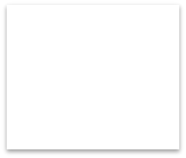

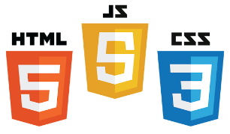
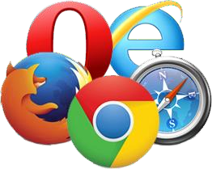



Web Applications
UI (Front End (DOM, Framework))
Request Layer (Web API)
Back End (Database, Logic)
Server
API Front End
Client
.
Browser
Logic
JSON
Internet
Database
Media Cache
34

Slide 24
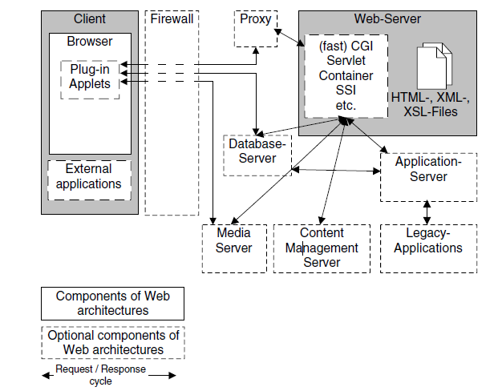
Components of a web application
Fig: Basic components of Web application architectures.

Slide 25
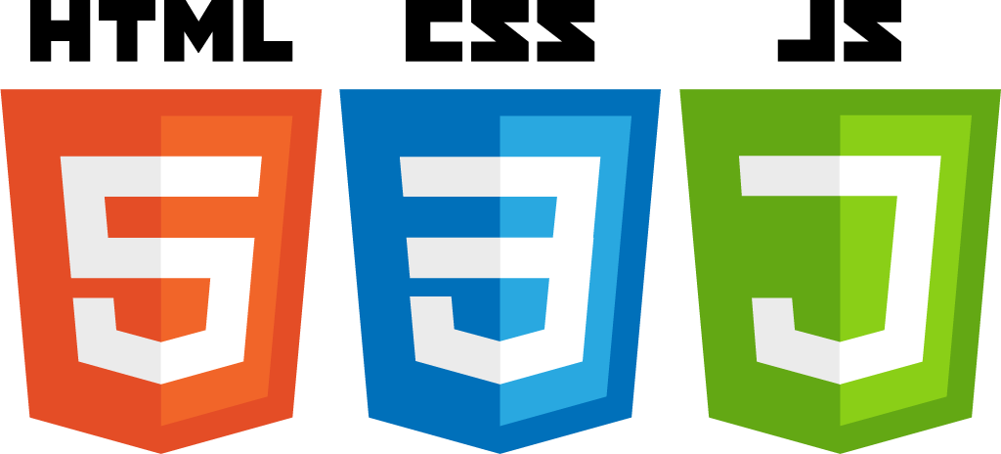
FRONTEND DEVELOPMENT

Slide 26
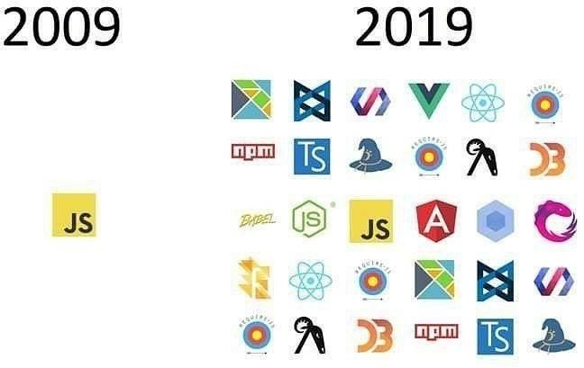
Front End Languages
HTML/CSS
JavaScript
Java (applets)
What is the most popular?
Answer: JavaScript/HTML/CSS is the only real option for front-end native languages and is basically the standard. But there are many variations on JavaScript that are used.
Today

Slide 27
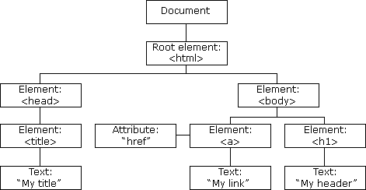
DOM (Document Object Model)
Document Object Model makes every addressable item in a web application an Object that can be manipulated for color, transparency, position, sound and behaviors.
Every HTML Tag is a DOM object

Slide 28
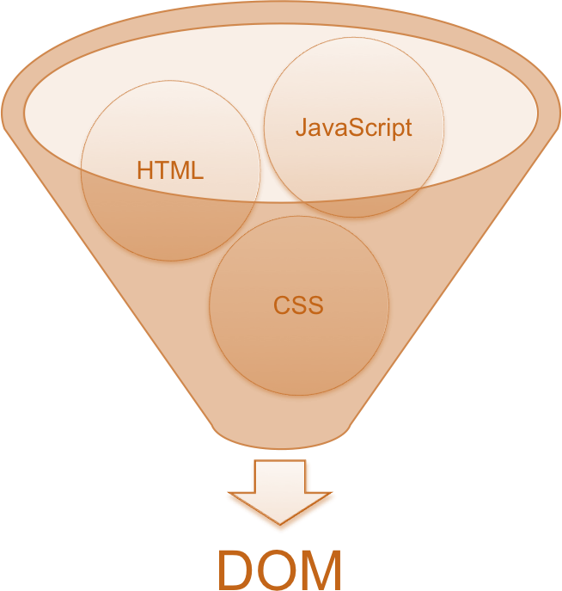
DOM (Document Object Model)

Slide 29
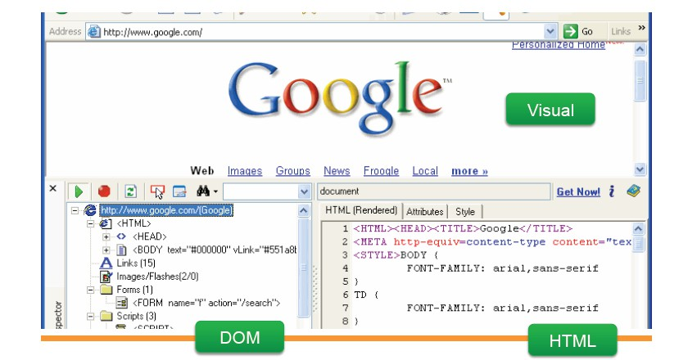
Three representations of same page
39

Slide 30
Software Architectural Pattern and Framework
Software Architectural Pattern
  An architectural pattern expresses a fundamental structural organization schema for software systems
  It provides a set of predefined subsystems, their responsibilities, and includes rules and guidelines for organizing the relationships between them
Software Framework
  A platform for developing software applications
  It provides a foundation on which software developers can build programs for a specific platform
  May include predefined classes and functions or APIs that can be used to process input, manage hardware/software components, etc.
40

Slide 31
MVC (Model View Controller)
Software architectural design pattern
Designed in 1970
Originally developed for desktop applications
– Most frequently used for web applications
Separates application functionality
Promotes modular programming
41

Slide 32













MVC Overview
Controller
1. Request
4. Response
Handles request flow
Do not handle data logic
2. Get data
3. Get view
Model
View
Handles data logic
Interacts with database
Handles data view
Dynamically render
42

Slide 33
Web Frameworks That Use MVC
Spring (Java)
ASP.NET MVC (C#)
Ruby on Rails (Ruby)
Laravel (PHP)
Django (Python)
Flask(Python)
AngularJS
React (JS)
Ember (JS)
Express (JS)
Vue (JS)
Polymer (JS)
43

Slide 34
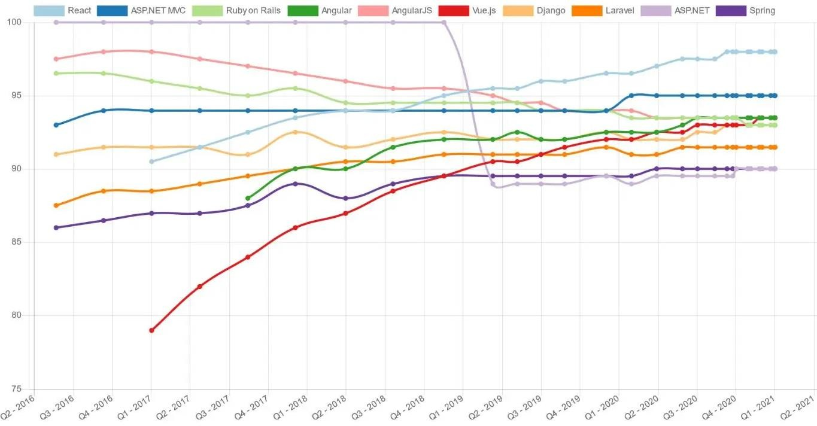
Popular frameworks
44
http://hotframeworks.com

Slide 35
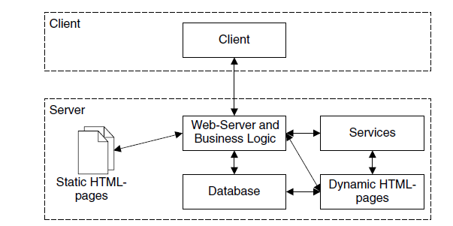
Layered Architectures
2-Layer Architectures
also called client/server architecture, uses a Web server to provide services to a client
This architecture is suitable particularly for simple Web applications.

Slide 36
N-layer architecture
allow us to organize a Web application in an arbitrary number of layers
typically consist of three layers,
  the data layer, providing access to the application data
  the business layer, hosting the business logic of the application in an application server
  the presentation layer, which renders the result of the request in the desired output format
2-layer and n-layer architectures differ mainly in how they embed services within the application server component.

Slide 37
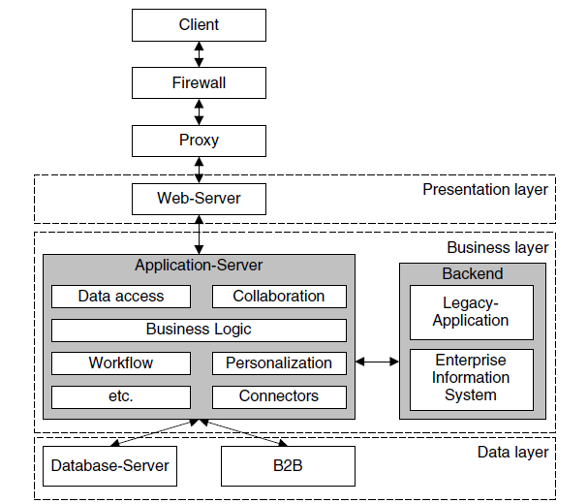
N-layer architecture

Slide 38
Modern Web Application Architecture
SPAs
it first loads the relevant web page and then dynamically updates the representation of its content with the requested information only.
In other words, it doesn’t refer to the server for loading new pages but sends requests for the needed parts of the webpage only.
Single Page Applications contribute to smoother performance and a more intuitive user experience.

Slide 39
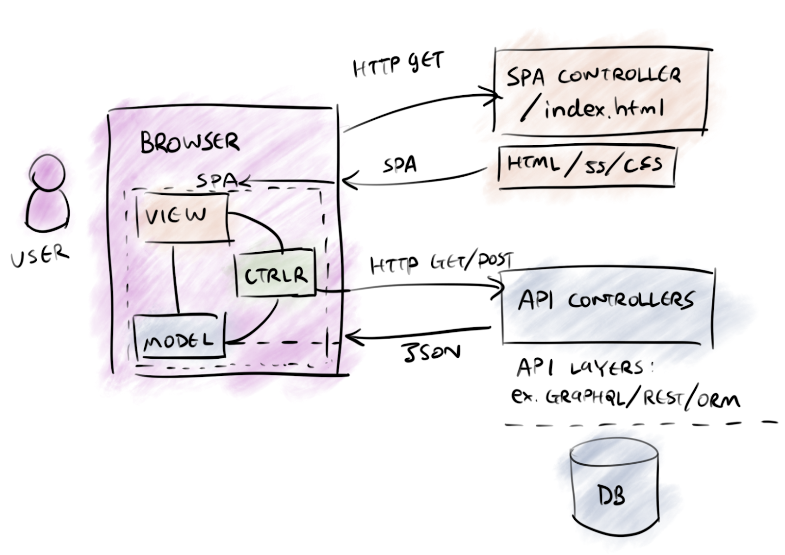
Single Page Apps- SPA

Slide 40
Microservice Architecture
Being the frequent alternative to an unreliable monolithic web application architecture, microservices disperse the functionality to deliver small and lightweight services separately.
They are loosely coupled and use APIs for communication if a sophisticated business problem arises.
Thanks to its flexibility and stability, microservice architecture has gained popularity these days, with businesses like Amazon, eBay, and Netflix adopting it for their complex needs.

Slide 41
Serverless Architecture
Outsource both server and infrastructure management to a third-party cloud service provider.
Choosing a serverless architecture is good for companies that want to delegate server and hardware management to a reliable tech partner and concentrate on front-end development tasks instead.
Also, this web application architecture type allows working on small functions in apps.
The service providers that assist in server management are Amazon and Microsoft, among others.

Slide 42
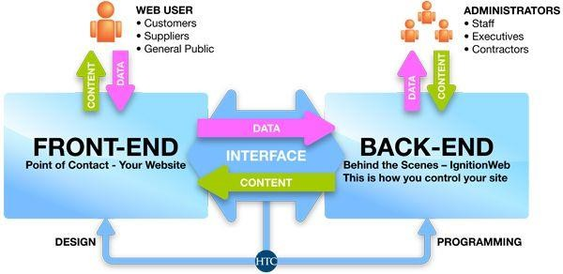
BACKEND DEVELOPMENT

Slide 43
What is a Backend?
All of the awesome that runs your application.
Web API
  Connection layer between the frontend and backend
  Connected through API calls (POST, GET, PUT, etc. )
  Transmit Content from the Backend to the Frontend commonly in JSON Blobs
Service Architecture that drives everything (Where all the logic is)
46

Slide 44
Web APIs
Application Programming Interface (API)
  Serves as an interface between different software programs and facilitates their interaction
  A particular set of rules and specifications that a software program can follow to access and make use of the services and resources provided by another particular software program
Web API
  The intermediate layer between front end and back-end systems
  A “must have” if your APIs will be consumed by third-party services
  Typically a defined set of HTTP request messages expressed in SOAP or REST along with a definition of the structure of response messages, typically expressed in JSON or XML.
47

Slide 45
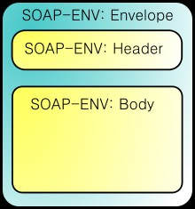
SOAP
Simple Object Access Protocol (SOAP)
SOAP Introduction:
  http://msdn.microsoft.com/en-us/library/ms995800.aspx
A SOAP message is an ordinary XML document containing the following
elements:
  An Envelope element that identifies the XML document as a SOAP message
  A Header element that contains header information
    contains application-specific information about the SOAP message
      optional
      must be the first child element of the Envelope element
  A Body element that contains call and response information
  A Fault element containing errors and status information
48

Slide 46


REST
Representational State Transfer (REST)
  Use HTTP method to invoke remote services (not XML)
The response of remote service can be in XML/JSON or any textual
format
Benefits:
  Easy to develop
  Easy to debug (with standard browser)
  Leverage existing web application infrastructure
49

Slide 47


Server Responses
Really Simple Syndication (RSS, Atom)
  XML-based standard
  Designed for news-oriented websites to “Push” content to readers
  Excellent to monitor new content from websites
XML or JavaScript Object Notation (JSON)
  Lightweight data-interchange format
  Human readable and writable and also machine friendly
  Wide support from most languages (Java, C, C#, PHP, Ruby, Python…)
Json: 48 bytes
XML: 83 bytes
50

